Slide 1

IS 504: Data Stats Presentation
Presented by
Alisha Shinde , Tanushree Poojary, Ankita Saha, Akanksha Agrawal, Prisha Singhania

Slide 2
Application domain
Domain: Fast Fashion Supply Chain Management
Objective: Investigate relationships between factors (factory, product, logistics) and KPIs (returns, profits, costs).
Purpose:
Improve quality control.
Optimize resource allocation.
Reduce operational costs.

Slide 3
The problem we are trying to solve
High Product Return Rates
Returns due to quality, sizing, or dissatisfaction.
Costly for companies.
Identifying Profitable Products
Hard to determine the most profitable items.
Difficulty in prioritizing production.
Shipping Delays and Inefficiencies
Delays impact customer satisfaction and costs.
Inefficient shipping increases expenses.

Slide 4
Importance of the Problem
The importance of this problem stems from the significant impact of inefficiencies and high costs within fast-fashion supply chains. Addressing these issues can lead to:
Improved profitability: Reducing returns, optimizing resource allocation, and lowering operational costs directly boost profitability.
Enhanced sustainability: Efficient supply chains contribute to reduced waste and a smaller environmental footprint
Broader Impact:
Increased customer satisfaction: Higher quality products and timely delivery enhance customer satisfaction and brand loyalty.
Competitive advantage: Companies that effectively manage their supply chains gain a competitive edge in the fast-paced fashion industry.

Slide 5
Beneficiaries
Companies: Save money, improve product quality, and increase profits.
Customers: Receive better products with faster delivery.
Supply Chain Managers: Make smarter, more efficient decisions.

Slide 6
Target Audience
Stakeholders in the fast fashion company: If this is a commissioned project, the target audience would also include those within the company who will use the findings to make decisions (e.g., management, operations teams).

Slide 7
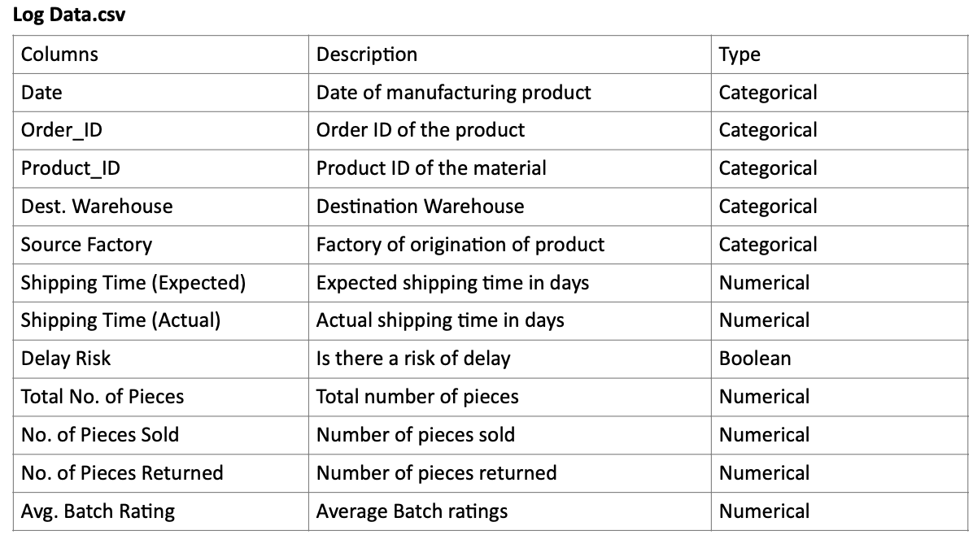
Dataset Overview
Source: We have selected the Fast Fashion Supply Chain dataset from Kaggle (The dataset can be accessed here). This dataset includes detailed records across four CSV files on product details, manufacturing costs, shipping data, warehouse shipping costs, and more. The total file size combining all the data is 4.7MBs approx.
Log Data.csv - 4.6 MB:
Notes:
We have selected the Fast Fashion Supply Chain dataset from Kaggle. The dataset consists of four files, each capturing different aspects of the supply chain.
First, we have Log Data.csv, which provides details about product orders. It includes key information like the manufacturing date, orderIDs and product IDs, the source factory, and the destination warehouse. It also tracks the expected and actual shipping times and flags any delay risks. Additionally, it records details for each batch(order), such as the total number of pieces shipped, sold, and returned, and provides an average batch rating for quality evaluation.

Slide 8
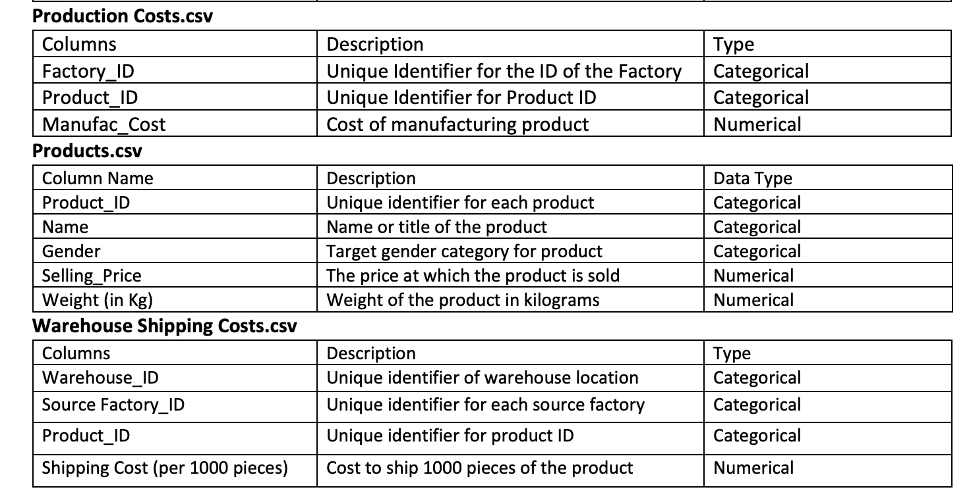
Dataset Overview Continued..
Products.csv - 1.2KB , Production Costs.csv - 5KB, Warehouse Shipping Costs.csv - 8.4KB
Notes:
Next is Production Costs.csv, which focuses on manufacturing costs. The dataset contains data from 5 factories, each producing a variety of products. The manufacturing cost varies depending on the factory where the product is made.
The Products.csv file gives insights into the 40 unique clothing and accessory items, including their names, target gender, weight, and selling prices. This file provides detailed information about the products themselves.
Finally, Warehouse Shipping Costs.csv highlights the logistics of moving products across 20 warehouses. Each warehouse sources different products from various factories, with shipping costs varying based on the product and factory.

Slide 9
Dataset Cleaning
For each of the four CSV files, we have majorly applied the following steps to prepare a clean data for further use:
1) Loading Libraries and Datasets:
Loaded the necessary libraries like dplyr, lubridate, and readr.
Imported datasets: Log Data, Warehouse Shipping Costs, Production Costs, and Products.
2) Standardizing Data:
Standardized key fields such as IDs and names by converting them to uppercase and trimming extra spaces to ensure consistency.
3) Handling Missing Values:
Filled missing values in numerical columns with their mean.
Removed rows with excessive missing data to maintain data quality.
4) Outlier Detection and Handling:
Identified outliers using the Interquartile Range (IQR) method.
Replaced extreme values with appropriate capped values or medians.
5) Optimizing Data Types:
Converted relevant columns to categorical data types to improve data usability and efficiency during analysis.
6) Saving Cleaned Data:
Saved the cleaned datasets as .rds files for future use.
These steps ensured the datasets were consistent, cleaned, and ready for further analysis.
Notes:
We began by loading some standard libraries and importing the datasets. Key fields were standardized by converting IDs and names to uppercase and trimming spaces. Missing values in numerical columns were filled with their mean, and rows with excessive missing data were removed. Outliers were identified using the IQR method and handled by capping or replacing them with medians. Relevant columns were converted to categorical data types, and the cleaned datasets were saved as .rds files for future use.

Slide 10
Research Question 1
Are products from certain factories more likely to be returned, and could a rating-based metric predict which products should undergo additional quality control?
Returns can indicate potential quality control issues, which can vary between factories due to production practices or materials used. We aim to determine if specific factories are linked to higher return rates and propose a predictive quality control measure based on existing product or production characteristics.
Notes:
In this question, we are trying to determine whether products from certain factories are more likely to be returned and whether a rating-based metric can predict which products should undergo additional quality control.
This involves a binary classification problem( since we are predicting high-return rates). A logistic regression model is usually appropriate for such problems.

Slide 11
Research Question 1 - Methods and Models
Methods Used: Exploratory Data Analysis
Models used: Logistic Regression
Key Steps involved:
1) Installed necessary packages and loaded the cleaned datasets ( (log_data, warehouse_costs, prod_costs, products )
2) Merged the datasets using inner joins on common keys, such as Product_ID, Source_Factory, and Dest_Warehouse, to create a single, unified dataset for analysis.
3) Created new features:
Return_Rate: The percentage of returned products compared to the sold products.
Profit_Margin: The profit made on each product, calculated only for positive margins.
Shipping_Delay: The delay in shipping time.
4) Created a binary variable, High_Return_Rate, where a value of 1 indicates a return rate above 7%. This will act as the dependent variable for the logistic regression model.
5) Selected key numerical variables, such as Return_Rate, Shipping_Delay, and Profit_Margin, to compute a correlation matrix.
Visualized the correlations using the corrplot package to identify relationships between variables.
6) Used logistic regression to predict High_Return_Rate using predictors like Shipping_Delay, Selling_Price, Avg_Batch_Rating, and Profit_Margin.
Checked the model summary to analyze the coefficients and their significance.
7) Calculated Variance Inflation Factor (VIF) to detect multicollinearity among predictors. A VIF below 8 indicates no significant multicollinearity issues.
8) Predicted probabilities and classified instances with a probability threshold of 0.5.
9) Evaluated the model using a confusion matrix and calculated its overall accuracy.
10) Highlighted the predictors with a p-value below 0.05, indicating their statistical significance in influencing the return rate which may help in future analysis using more advanced models like the Random Forrest Model etc.

Slide 12
Research Question 1 - Methods and Models
Evaluation Metrics:
Correlation Analysis: Checked the strength of relationships between predictor variables and return rates.
Significance Testing: Evaluated the p-values of coefficients to determine their statistical significance after applying the GLM function with family = Binomial and analyzed the summary of the model
Variance Inflation Factor (VIF): Assessed multicollinearity among independent variables.
Confusion Matrix: Analyzed the model's classification performance by comparing actual vs. predicted outcomes.
Model Accuracy: Calculated the percentage of correctly predicted classifications to assess overall performance.

Slide 13
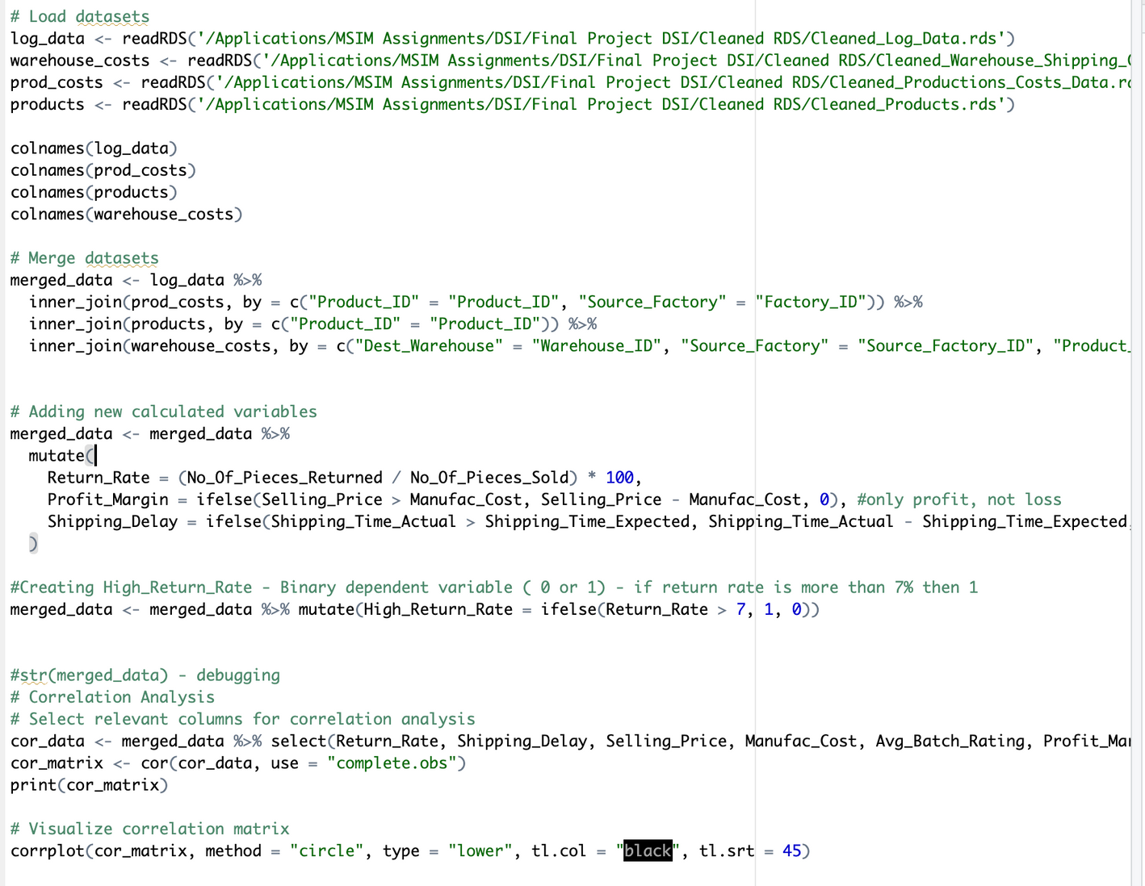
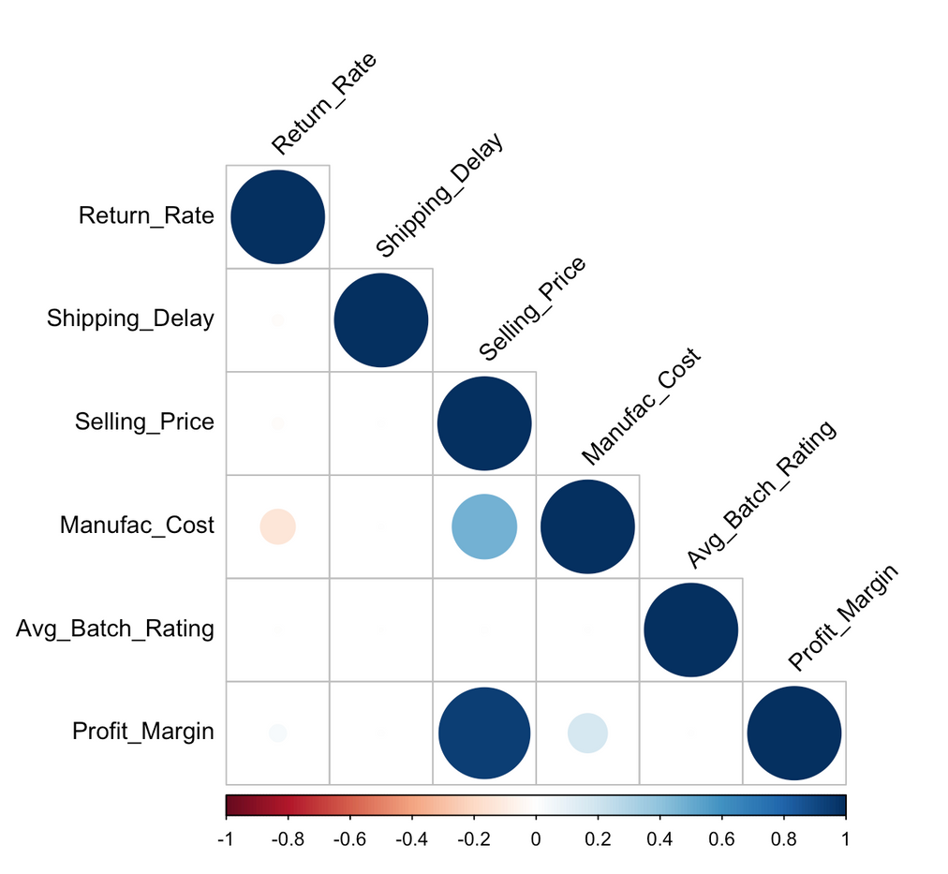
Research Question 1 - Code Screenshots

Slide 14
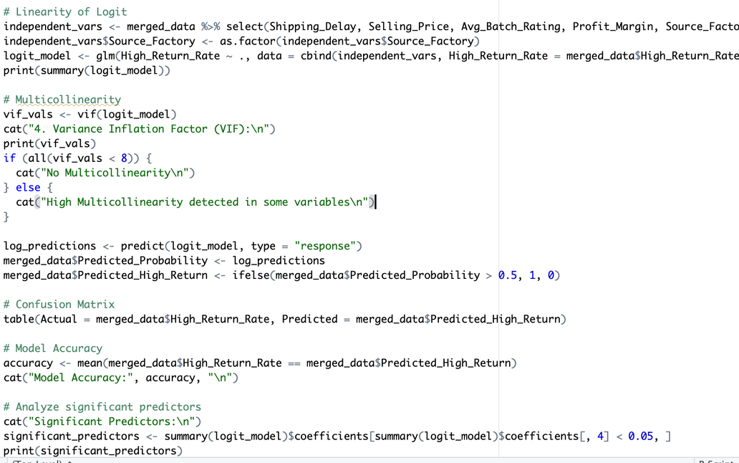
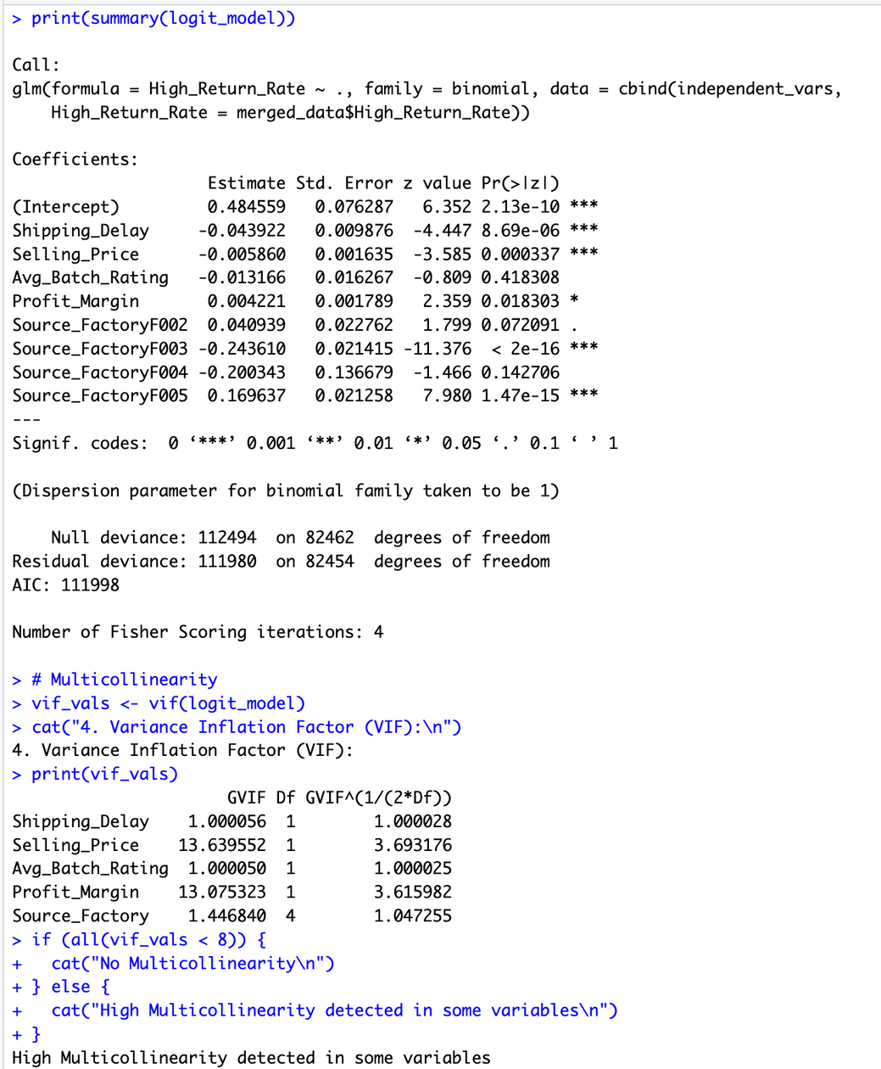
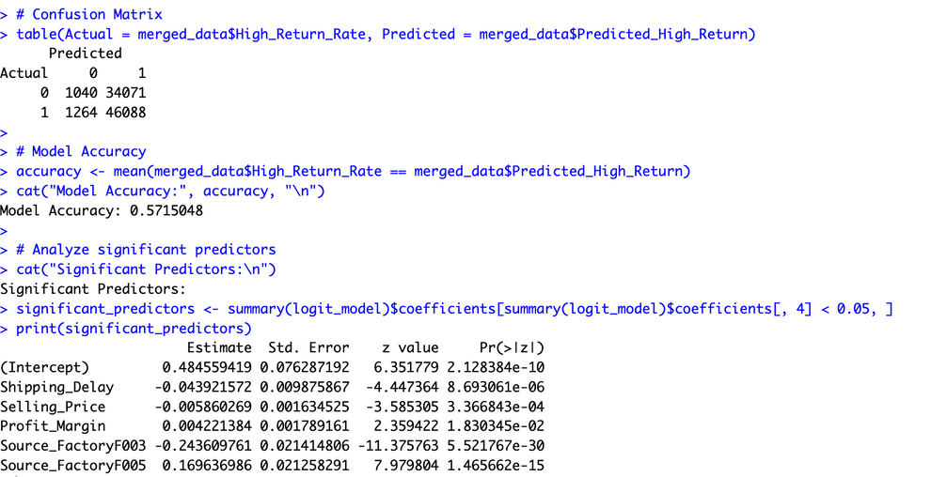
Research Question 1 - Code Screenshots
Notes:
On the right side, we have output summary of glm function :
these represent the log-odds of the dependent variable (High_Return_Rate) being 1 when the corresponding independent variable increases by one unit (holding other variables constant).
Smaller p-values (typically < 0.05) suggest that the predictor has a statistically significant effect on the dependent variable.
High collinearity for some predictors indicates that predictors are strongly correlated, which can lead to unreliable coefficient estimates.

Slide 15
Research Question 1 - Findings
Key Finding:
Weak correlations between Return_Rate and predictors suggest that other unexamined factors or non-linear relationships might influence return rates.
The confusion matrix shows the model predicts "High Return Rate" frequently, resulting in high true positives but many false positives as well
The model achieved an accuracy of 57.15%, which is slightly better than random guessing but indicates limited predictive power.
Conclusion: Logistic regression may not be the best fit due to the lack of strong linear relationships and potential violations of model assumptions.

Slide 16
Research Question 1
What factors contribute to a high risk of product returns, and how effectively can we predict this risk based on metric-rating available in the sales data?
Using
Logistic Regression

Slide 17
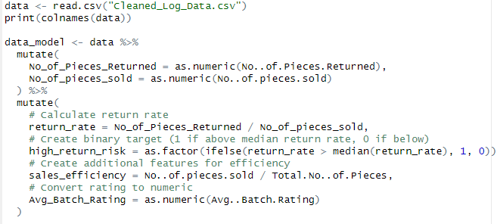
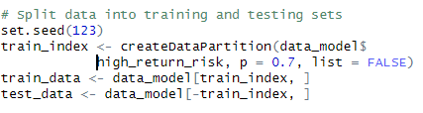
Research Question 1
Data Preparation

Slide 18
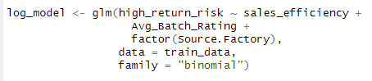
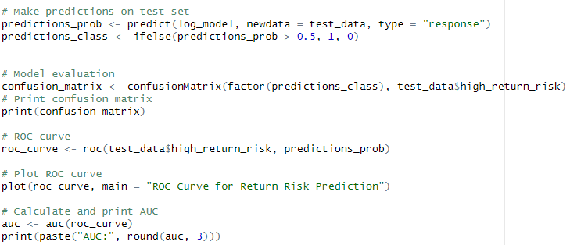
Research Question 1
Logistic Model

Slide 19
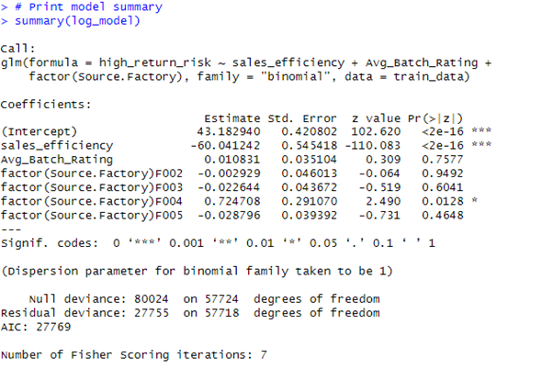
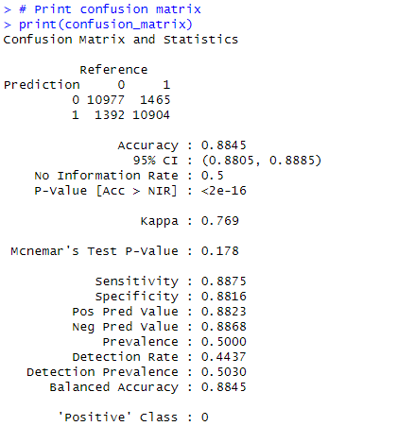
Research Question 1
The resulting confusion matrix shows four key values:
True Positives (TP): Correctly predicted high-risk batches
True Negatives (TN): Correctly predicted low-risk batches
False Positives (FP): Incorrectly predicted high-risk batches
False Negatives (FN): Incorrectly predicted low-risk batches

Slide 20
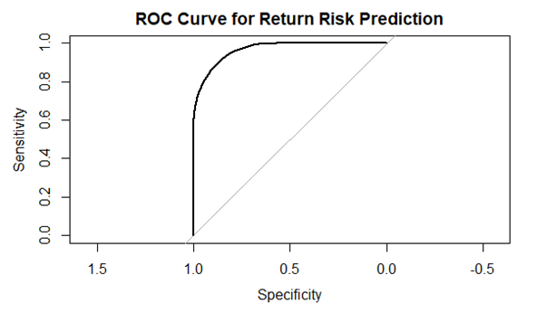
Research Question 1
Accuracy: (TP + TN) / Total predictions
Sensitivity: TP / (TP + FN)
Specificity: TN / (TN + FP)
Precision: TP / (TP + FP)
A ROC curve, which stands for "Receiver Operating Characteristic" curve, is a graphical representation of a classification model's performance across different classification thresholds, plotting the true positive rate (sensitivity) against the false positive rate (1-specificity) at various cut-off points

Slide 21
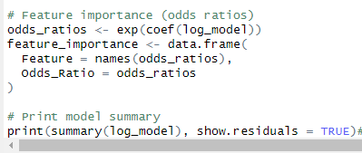
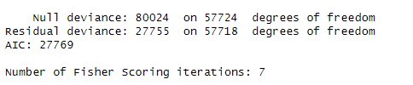
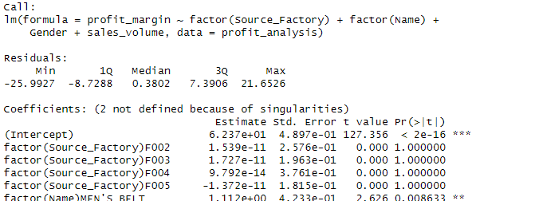
Research Question 1
AIC – Akaike Infromation criterion - The Akaike information criterion (AIC) is a mathematical method for evaluating how well a model fits the data it was generated from.
The Fisher scoring algorithm is an iterative method that uses the expected Fisher information matrix to estimate the parameters of a statistical model.

Slide 22
Research Question - 2
Are there specific product categories or factories that yield higher profit margins due to lower manufacturing costs or higher selling prices?
Using
ANOVA and Multiple Linear Regression

Slide 23
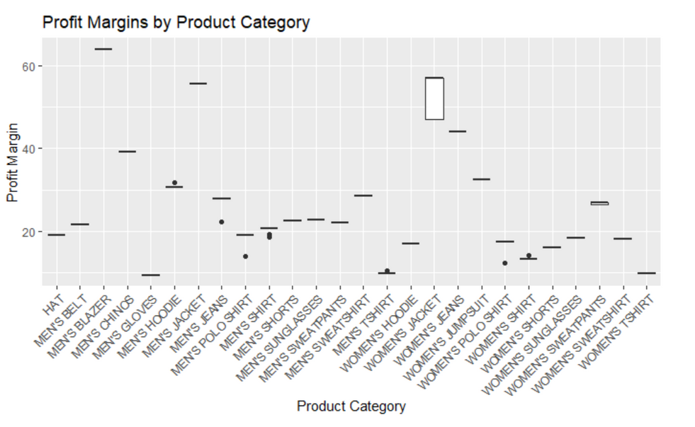
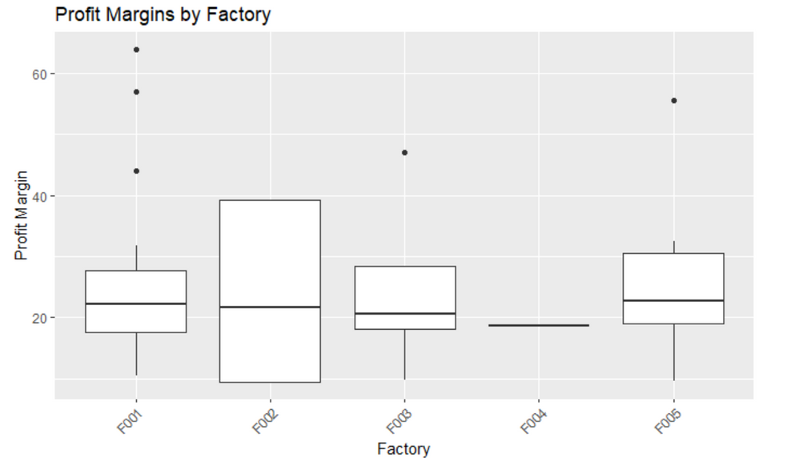
Research Question - 2
Models used: ANOVA
Comparing multiple groups: ANOVA allows the comparison of means across various product categories and factories.
Continuous dependent variable: Profit margin is constant, meeting ANOVA's requirement.
Categorical independent variables: Product categories and factories are categorical, and suitable for ANOVA.
Interaction effects: Two-way ANOVA captures both main and interaction effects.

Slide 24
Research Question - 2 ANOVA
Evaluation Metrics:
Violation of Homogeneity of Variances: Levene's test showed significant p-values (p < 2.2e-16).
Non-normality of Residuals: Residuals may not follow a normal distribution.
Unequal Sample Sizes: Significant differences in group sizes can affect robustness.
Extreme Outliers: Outliers in profit margins may distort results.
Non-linear Relationships: ANOVA assumptions are violated if relationships are non-linear.
Complex Interactions: Interaction effects between product categories and factories may not be fully captured by standard ANOVA.
Key Finding:
There are significant differences in profit margins among both product categories and factories.
The violation of the homogeneity of variances assumption suggests that we should interpret these results with caution and consider using robust ANOVA methods or non-parametric alternatives.

Slide 25
Research Question - 2
Reasons for not using ANOVA
Flexible models like Linear Mixed Effects Models or Multiple Linear Regression are better suited, as they incorporate categorical and continuous predictors, account for variability, and provide deeper insights into factors influencing profit margins.

Slide 26
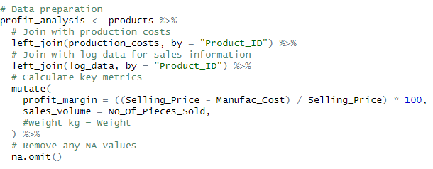
Research Question - 2
Model Used - Multiple Linear Regression

Slide 27
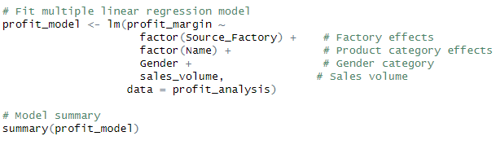
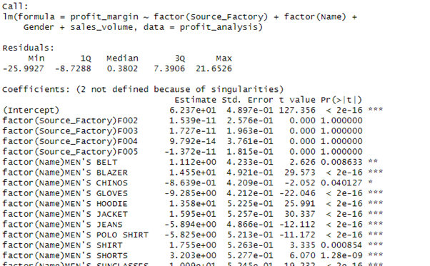
Research Question - 2
Linear Regression model
Looks good since centered at 0, and the values are roughly symmetrical

Slide 28
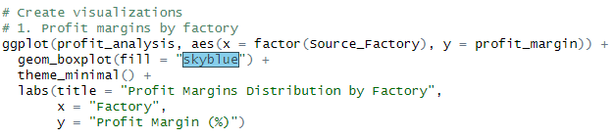
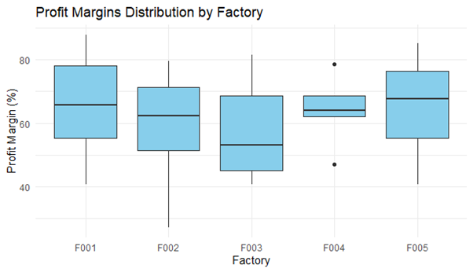
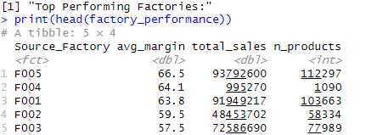
Research Question - 2

Slide 29
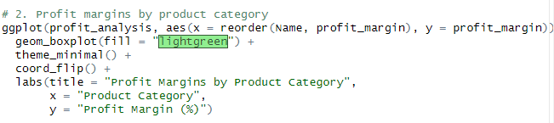
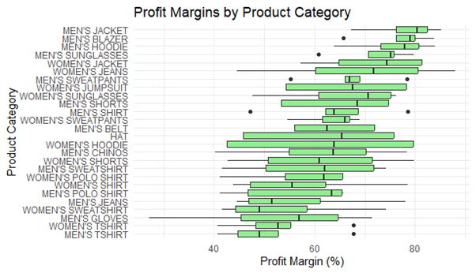
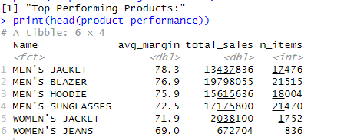
Research Question - 2

Slide 30
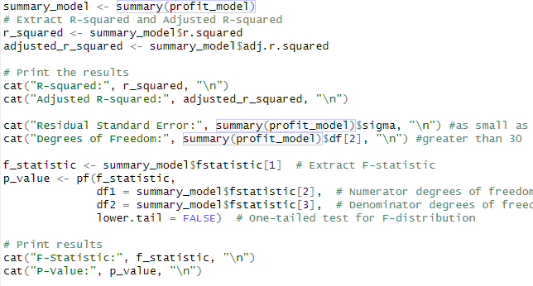
Research Question - 2
Key Findings -

Slide 31
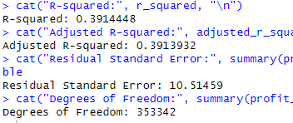
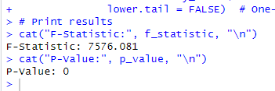
Research Question - 2
Key Findings -
R-Squared - As close to 1 as possible
Adjusted R-squared - Largest possible
Residual Standard Error - As small
Degree of Freedom - More than 30
F statistic should be relatively large and p-value should be relatively smaller, typically less than 0.05 so that at least one of the independent variables significantly contributes to explaining the variation in the dependent variable.

Slide 32
Research question 3
Question 3) How do specific operational decisions (e.g., timing of shipments, warehouse selection) influence the total cost incurred for production and shipping?
Operational decisions like shipment timing and warehouse selection directly impact costs. Delaying shipments can lead to rush fees, while early shipments may increase storage costs. Choosing a warehouse closer to key markets reduces shipping costs and delivery times, while distant warehouses raise transportation costs. Smarter decisions in these areas can lower overall production and shipping expenses.

Slide 33
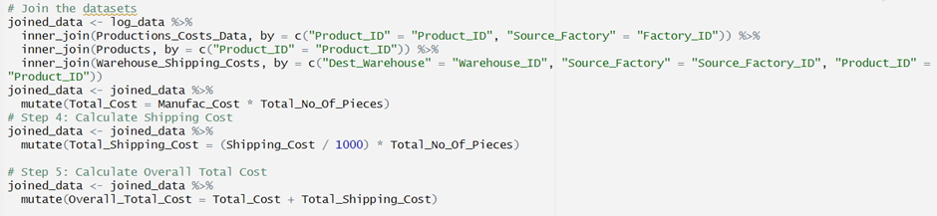
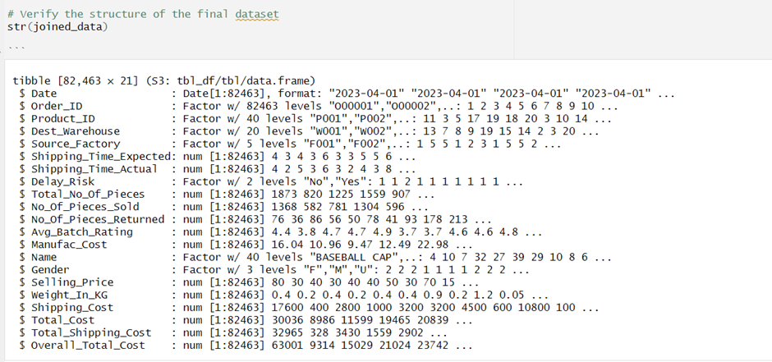
Research Question 3 - Methods and Models
Methods Used: Data Preprocessing

Slide 34
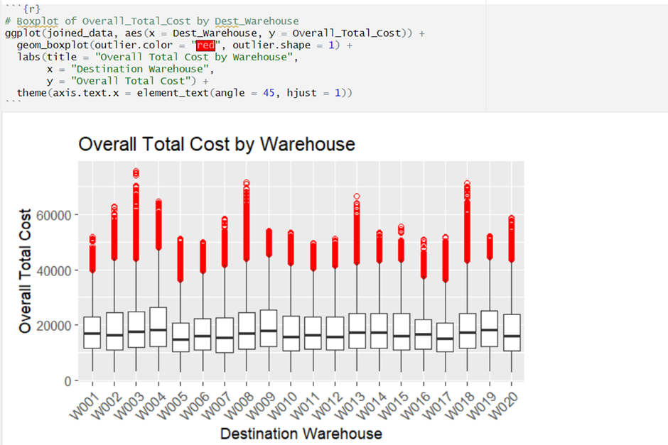
Research Question 3 - Methods and Models
Evaluation Metrics:

Slide 35
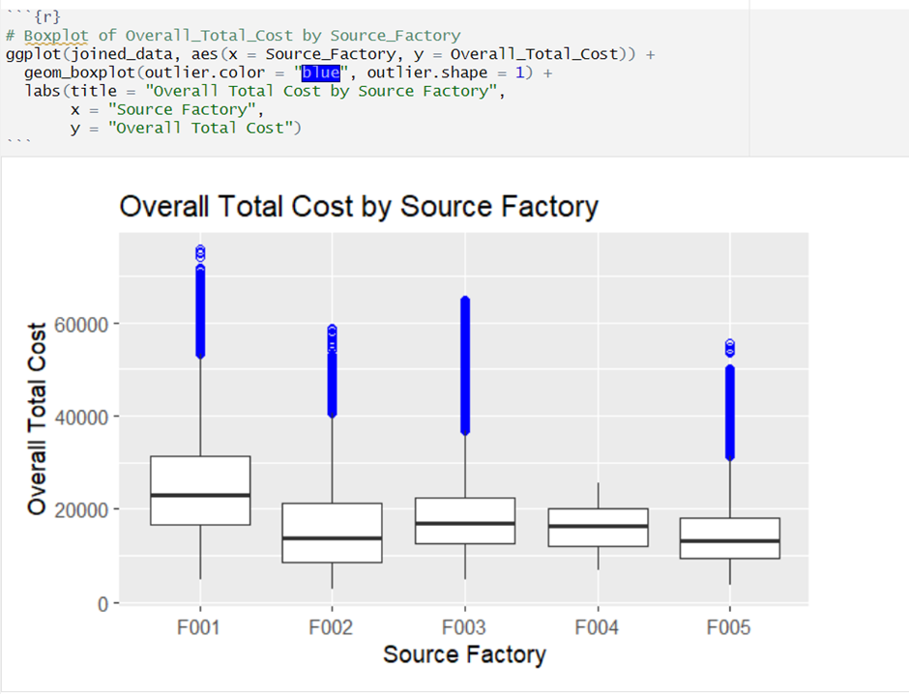
Research Question 3 - Methods and Models
Evaluation Metrics:

Slide 36
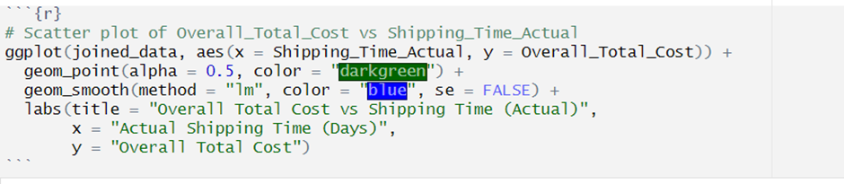
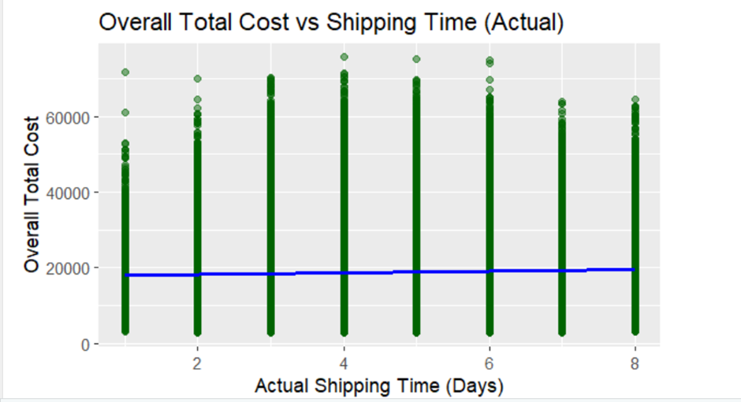
Research Question 3 - Methods and Models
Evaluation Metrics:

Slide 37
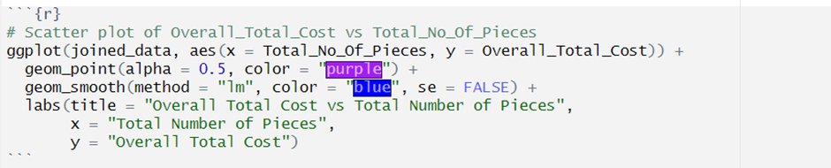
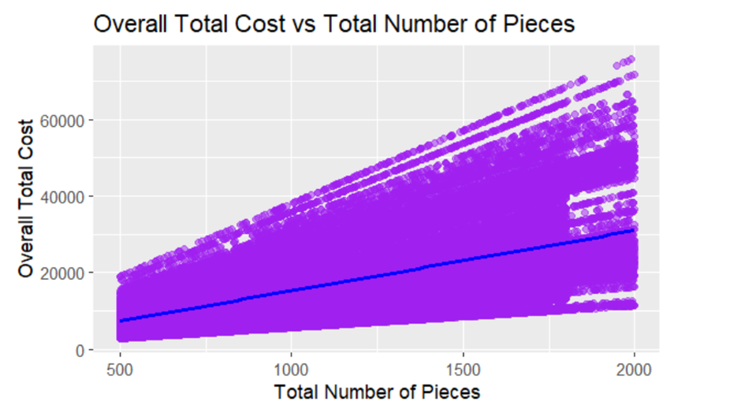
Research Question 3 - Methods and Models
Evaluation Metrics:

Slide 38
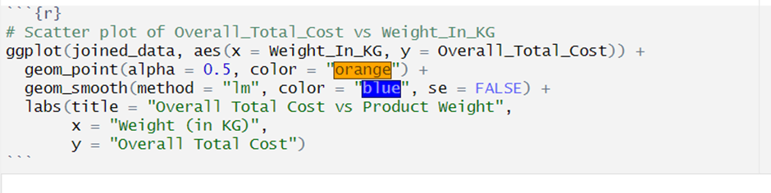
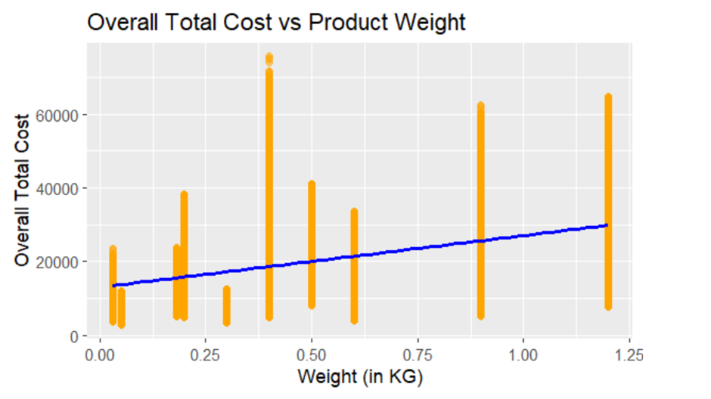
Research Question 3 - Methods and Models
Evaluation Metrics:

Slide 39
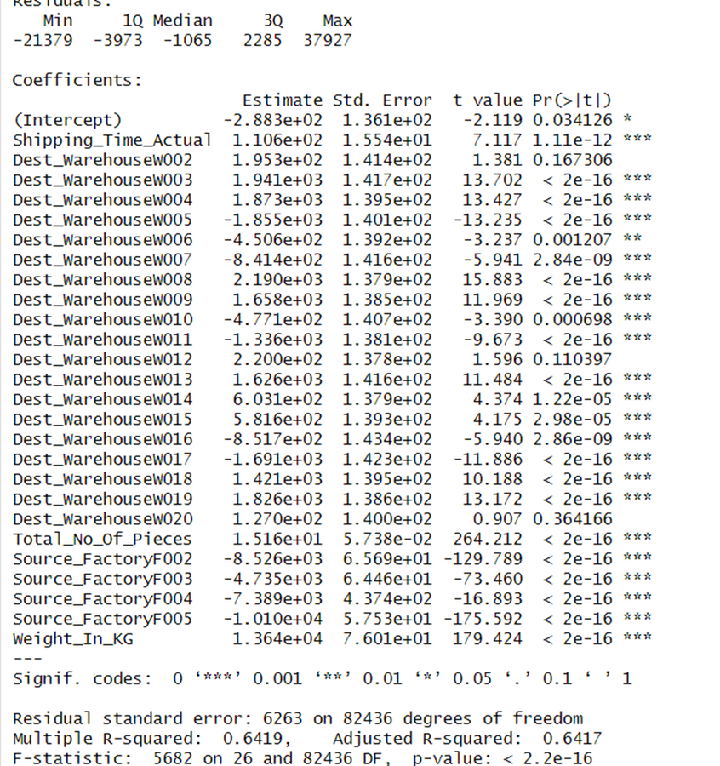
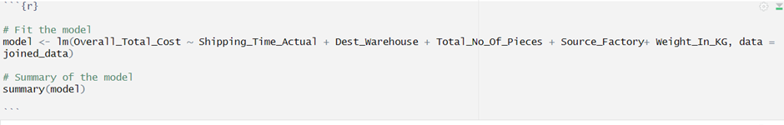
Research Question 3 - Methods and Models
Evaluation Metrics:

Slide 40
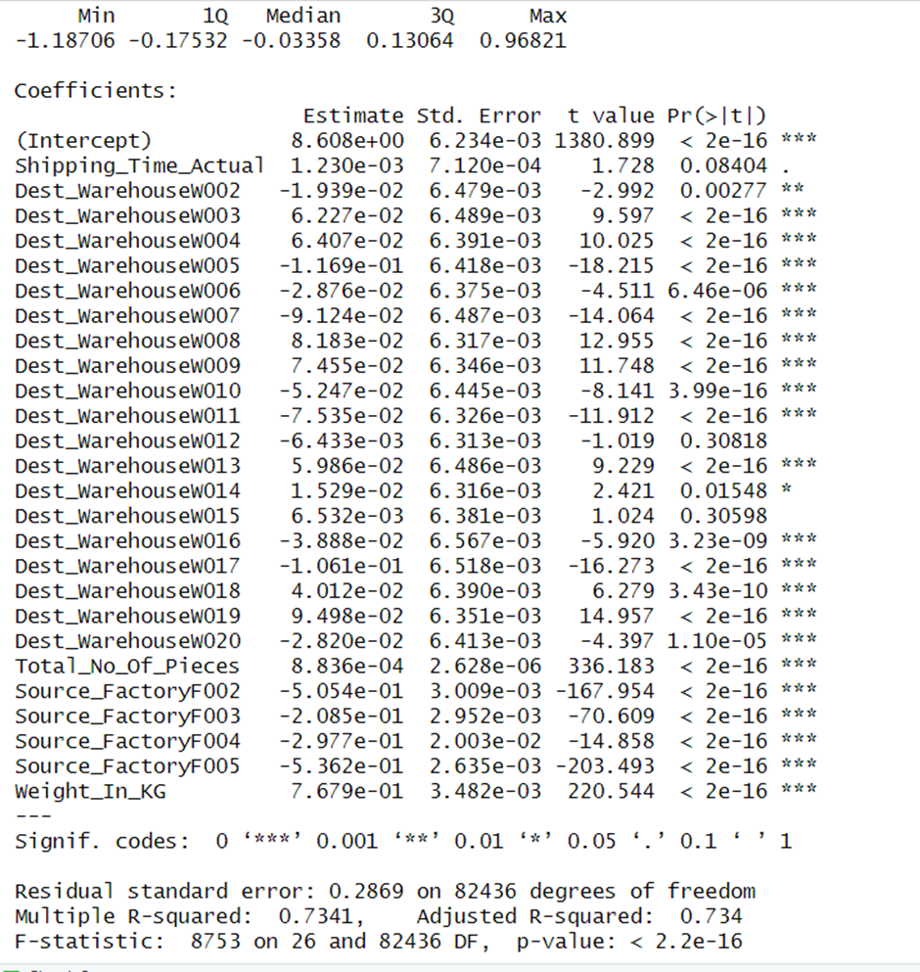
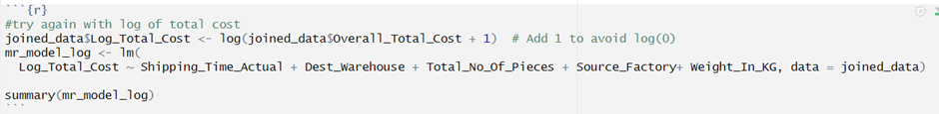
Research Question 3 - Methods and Models
Evaluation Metrics:

Slide 41
Research Question 3 - Methods and Models
Key Finding:
The Adjusted R-squared value of 0.734 indicates that approximately 73.4% of the variability in the log-transformed total cost is explained by the model, accounting for the number of predictors included.
1. Impact of Shipping Time: The coefficient for Shipping_Time_Actual indicates a small but positive relationship with Log_Total_Cost, suggesting that slightly higher costs are associated with longer shipping times.
2. Warehouse Selection Matters: Warehouses like W005 and W007 show significantly lower costs, while others like W003 and W004 contribute to higher costs, highlighting the critical role of warehouse logistics in cost optimization.
3. Production and Product Weight Dominate Costs: Variables like Total_No_Of_Pieces, Source_Factory, and Weight_In_KG have the most substantial impact on costs, with *Weight_In_KG* being a particularly strong positive driver, reflecting its direct influence on shipping and handling expenses.

Slide 42
Recommendations for Fast-Fashion Company Stakeholders:
Enhance Quality Control: Target high-return factories; use a rating system for proactive quality checks.
Optimize Resource Allocation: Prioritize high-margin products and factories based on cost and price analysis.
Improve Logistics: Strategically choose warehouses (prioritize W005, W007); optimize shipping times; consider product weight.
Embrace Data-Driven Decisions: Continuously collect and analyze supply chain data for ongoing improvements.

Slide 43
Reflection on the Project
Robust Statistical Methods: Address ANOVA assumption violations by utilizing robust statistical methods or non-parametric alternatives from the outset to handle outliers and normality issues.
Advanced Modeling Techniques: Consider using generalized linear models, mixed-effects models, or machine learning algorithms to capture complex variable relationships and enhance predictive accuracy.
Expanded Data Collection: Incorporate additional factors like material quality, supplier performance, and customer feedback to better explain cost variations and return rates.
Improved Visualizations: Develop more interactive dashboards to effectively communicate key findings to a broader audience.

Slide 44
Thank You

